Slide 1
Table of Contents
Basics – Time Series Modeling
Exploration of Time Series Data in R
Introduction to ARMA Time Series Modeling
Framework and Application of ARIMA Time Series Modeling

Slide 2
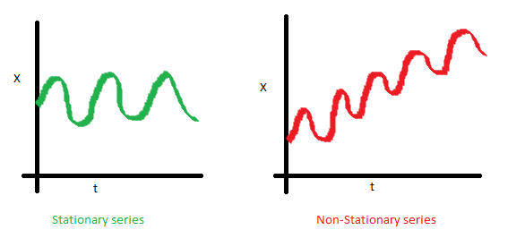
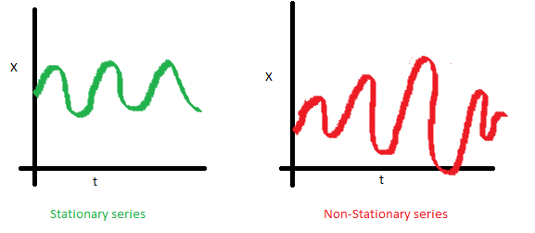
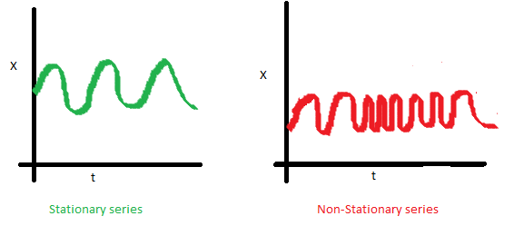
There are three basic criterion for a series to be classified as stationary series :
The mean of the series should not be a function of time rather should be a constant.
The variance of the series should not a be a function of time. This property is known as homoscedasticity.
The covariance of the i th term and the (i + m) th term should not be a function of time.

Slide 3
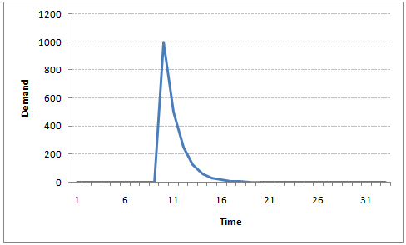
Auto-Regressive Time Series Model
Let’s understanding AR models using the case below:
The current GDP of a country say x(t) is dependent on the last year’s GDP i.e. x(t – 1).
The hypothesis being that the total cost of production of products & services in a country in a fiscal year (known as GDP) is dependent on the set up of manufacturing plants / services in the previous year and the newly set up industries / plants / services in the current year.
But the primary component of the GDP is the former one.
Hence, we can formally write the equation of GDP as:
x(t) = alpha * x(t – 1) + error (t)
This equation is known as AR(1) formulation. The numeral one (1) denotes that the next instance is solely dependent on the previous instance. The alpha is a coefficient which we seek so as to minimize the error function. Notice that x(t- 1) is indeed linked to x(t-2) in the same fashion. Hence, any shock to x(t) will gradually fade off in future.
For instance, let’s say x(t) is the number of juice bottles sold in a city on a particular day. During winters, very few vendors purchased juice bottles. Suddenly, on a particular day, the temperature rose and the demand of juice bottles soared to 1000. However, after a few days , the climate became cold again. But, knowing that the people got used to drinking juice during the hot days, there were 50% of the people still drinking juice during the cold days. In following days, the proportion went down to 25% (50% of 50%) and then gradually to a small number
after significant number of days. The following graph explains the inertia property of AR series:

Slide 4
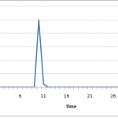
Moving Average Time Series Model
Let’s take another case to understand Moving average time series model.
A manufacturer produces a certain type of bag, which was readily available in the market. Being a competitive market, the sale of the bag stood at zero for many days. So, one day he did some experiment with the design and produced a different type of bag. This type of bag was not available anywhere in the market. Thus, he was able to sell the entire stock of 1000 bags (lets call this as x(t) ). The demand got so high that the bag ran out of stock. As a result, some 100 odd customers couldn’t purchase this bag. Lets call this gap as the error at that time point. With time, the bag had lost its woo factor. But still few customers were left who went empty handed the previous day.
Following is a simple formulation to depict the scenario :
x(t) = beta * error(t-1) + error (t)
If we try plotting this graph, it will look something like this :
Did you notice the difference between MA and AR model? In

Slide 5
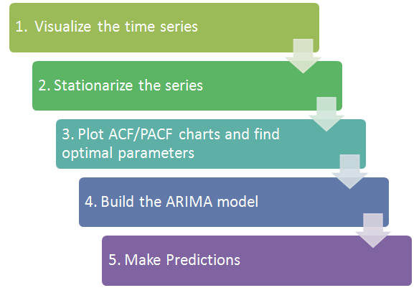
Overview of the Framework
This framework(shown below) specifies the step by step approach on ‘How to do a Time Series Analysis‘:

Slide 6
There are three commonly used technique to make a time series stationary:
1. Detrending : Here, we simply remove the trend component from the time series. For instance, the equation of my time series is:
x(t) = (mean + trend * t) + error
We’ll simply remove the part in the parentheses and build model for the rest.
2. Differencing : This is the commonly used technique to remove non-stationarity. Here we try to model the differences of the terms and not the actual term. For instance,
x(t) – x(t-1) = ARMA (p , q)
This differencing is called as the Integration part in AR(I)MA. Now, we have three parameters
p : AR
d : I
q : MA
3. Seasonality : Seasonality can easily be incorporated in the ARIMA model directly.

